Slide 1
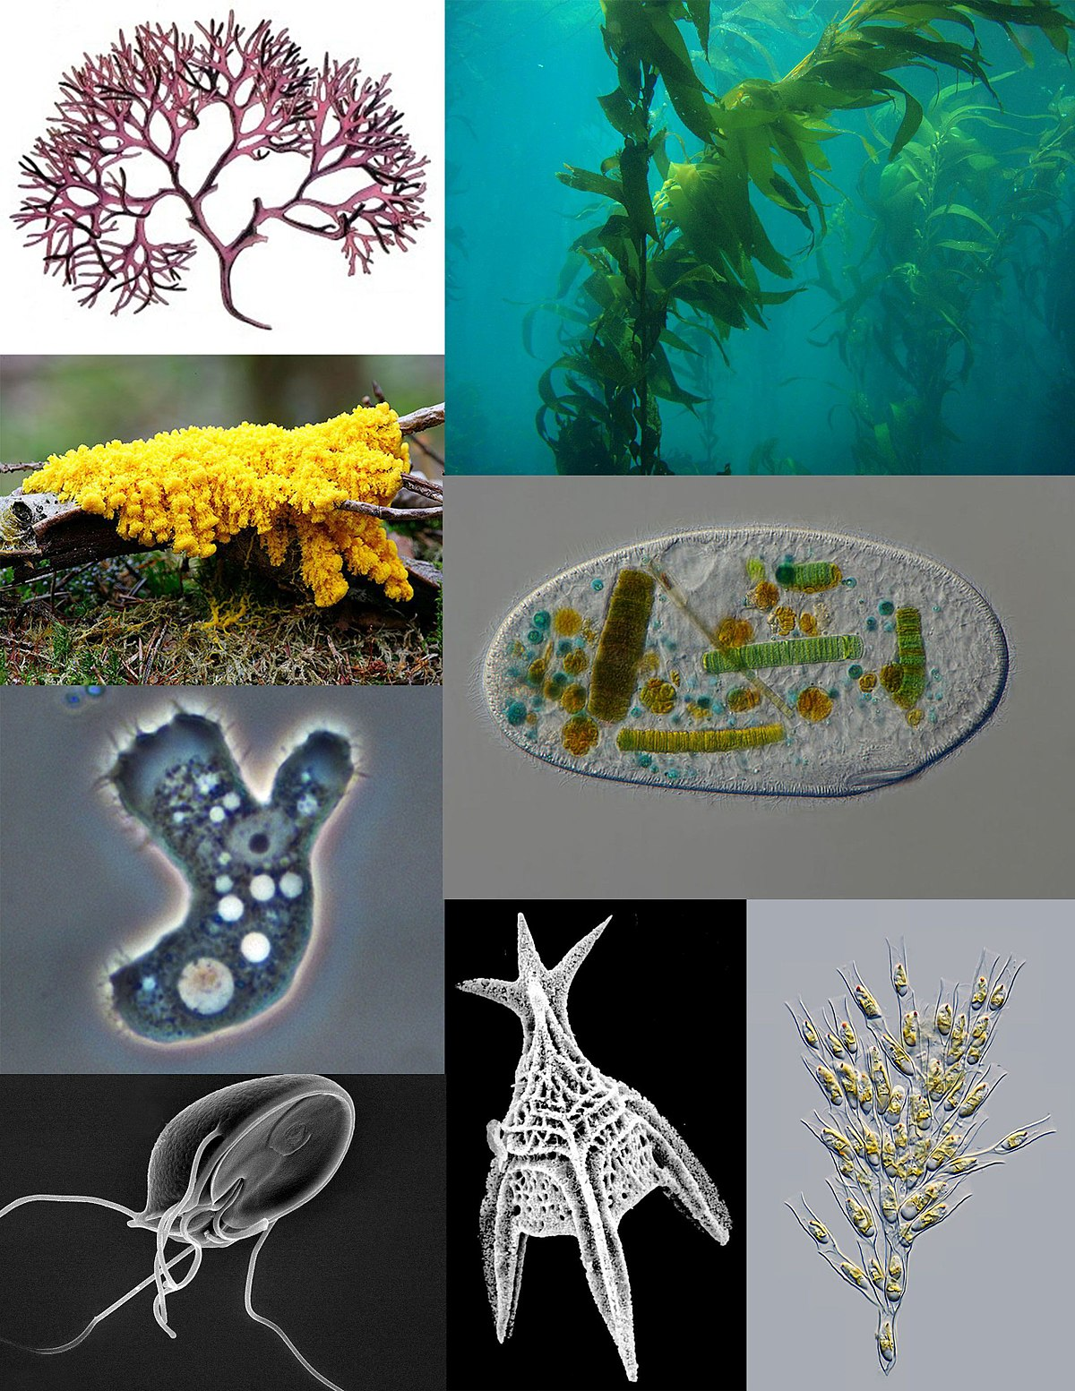
Protists

Slide 2
Learning Goals
Provide examples of how protists play key roles in our world
Identify key differences between cells of protists and prokaryotes
Explain the evidence that supports the endosymbiotic theory of eukaryotic origins
Interpret information from a phylogenetic tree
Identify protist lineages that gave rise to animals, plants, and fungi

Slide 3
Learning Goals
Provide examples of how protists play key roles in our world

Slide 4
Protists play key roles in our world
Symbiosis- interaction between two different organisms living in close physical association
Many protists form symbiotic relationships with other organisms

Slide 5
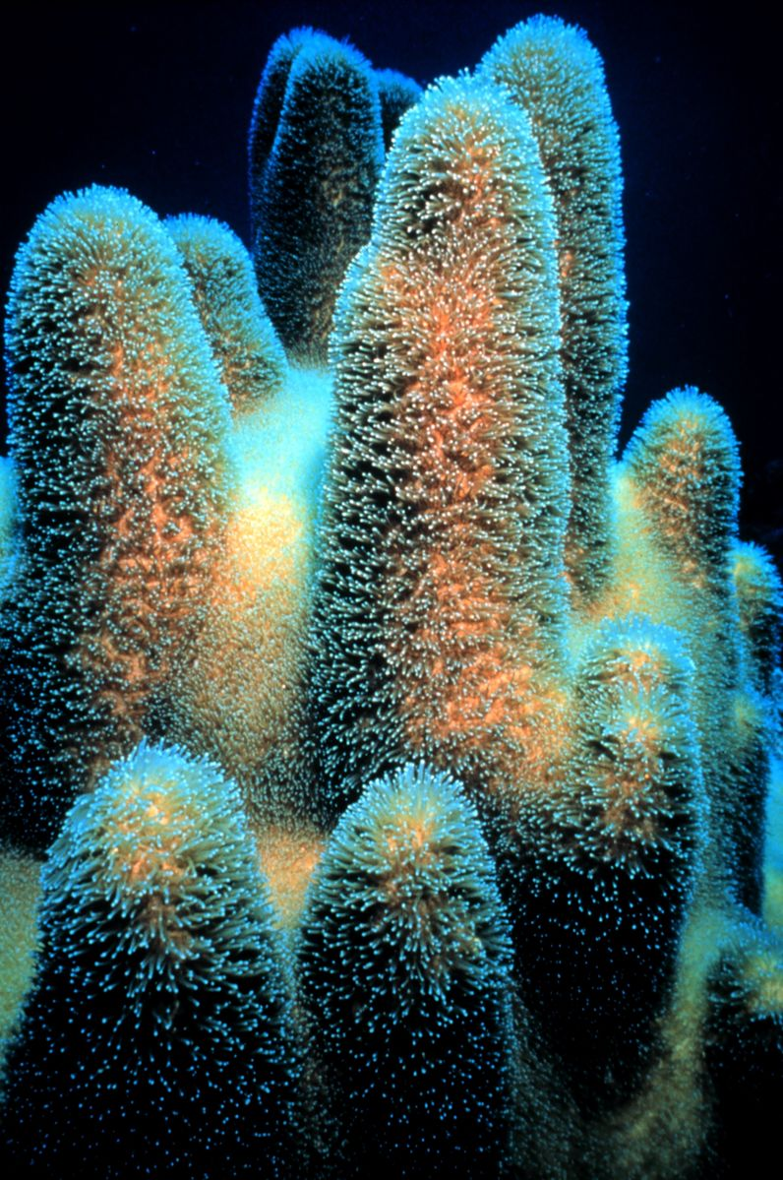
Dinoflagellates and coral
Photosynthetic dinoflagellates are a a group of protists that form a symbiotic relationship with corals
Corals depend on these protists
Tropical coral reefs ecosystems could not exist without protists

Slide 6
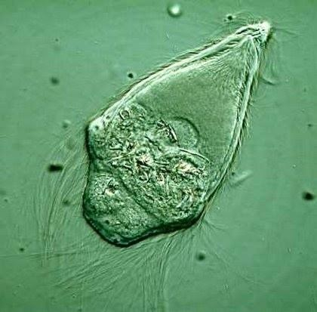
Trychonympha and termites
Wood-digesting protists in the genus Trychonympha live in the hindgut of lower termites and wood roaches and help them digest wood
Termites do $3.5 billion in damage to homes in the US each year

Slide 7
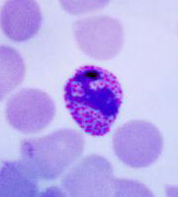
Malaria and humans
Malaria is a life-threatening disease caused by a protist (Plasmodium) that are transmitted to people through the bites of infected mosquitoes
In 2018, there were an estimated 228 million cases of malaria worldwide, resulting in 405,000 deaths
67% of these deaths were children less than 5 years old

Slide 8
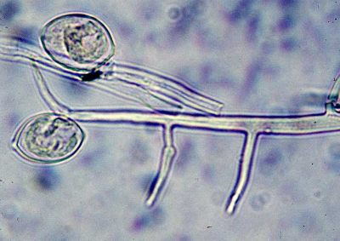
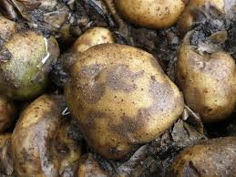
Crop diseases and famine
The The Irish Potato Famine was caused by the protist Phytophthora
Between 1845-1849, it killed 75% of the potato crop
One million people died of starvation, one million more became refugees. Many came to the United States.

Slide 9
Protists

Slide 10
Learning Goals
Identify key differences between cells of protists and prokaryotes

Slide 11
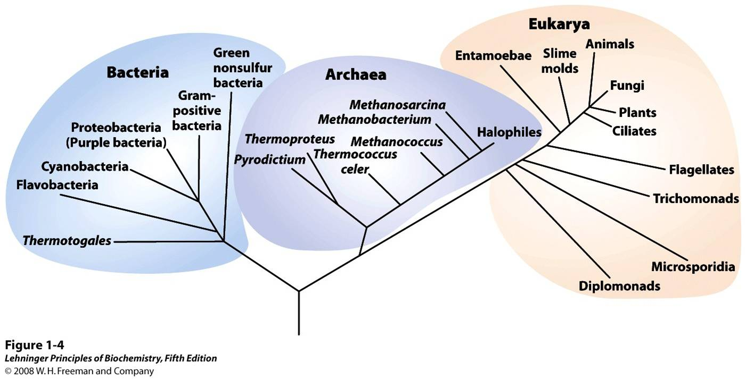
Domain Eukaryota

Slide 12
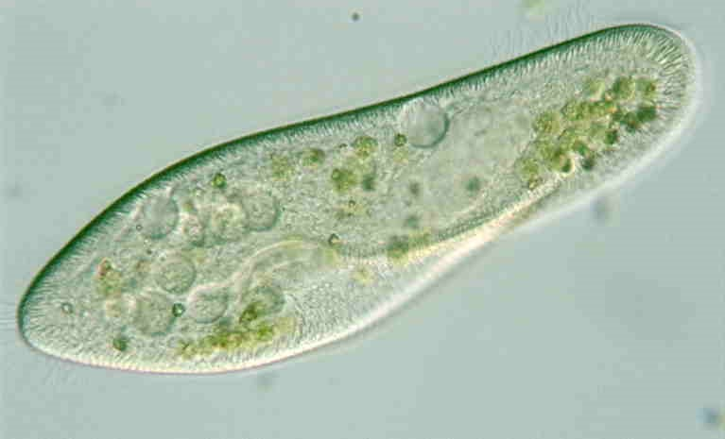
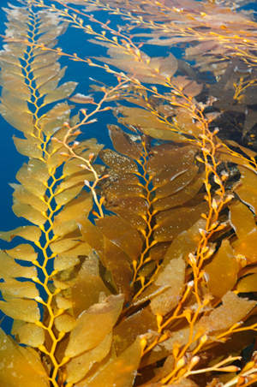
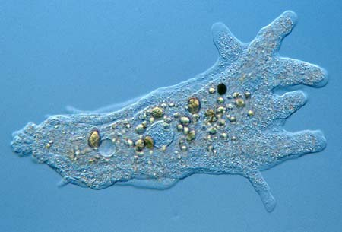
Most (not all) protists are unicellular

Slide 13
Key differences between cells of protists and prokaryotes
Eukaryotes can be defined by their cell structure
Eukarotes have a cytoskeleton
Eukaryotes have a nucleus and cell organelles
This allows localization of specific cell functions

Slide 14
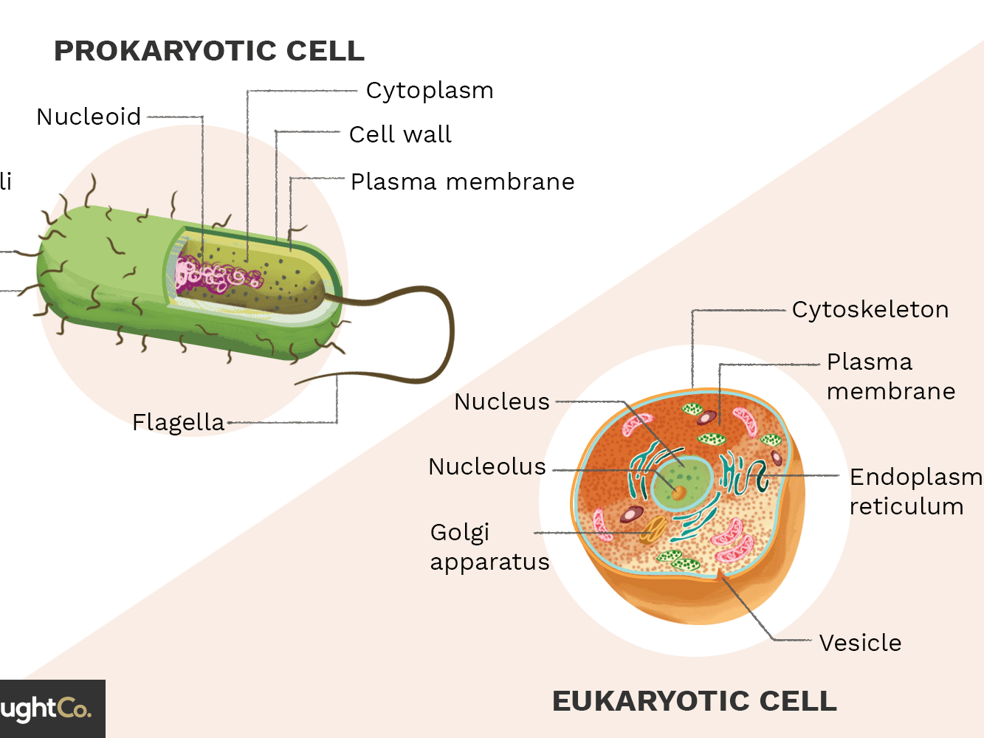
Eukaryotic organisms exhibit cellular specialization

Slide 15
Protist metabolism
Some protists are photoautotrophic
Some protists are heterotrophic
Some protists are mixotrophic, relying on photoautotrophy when light is available, and heterotrophy when it is not

Slide 16
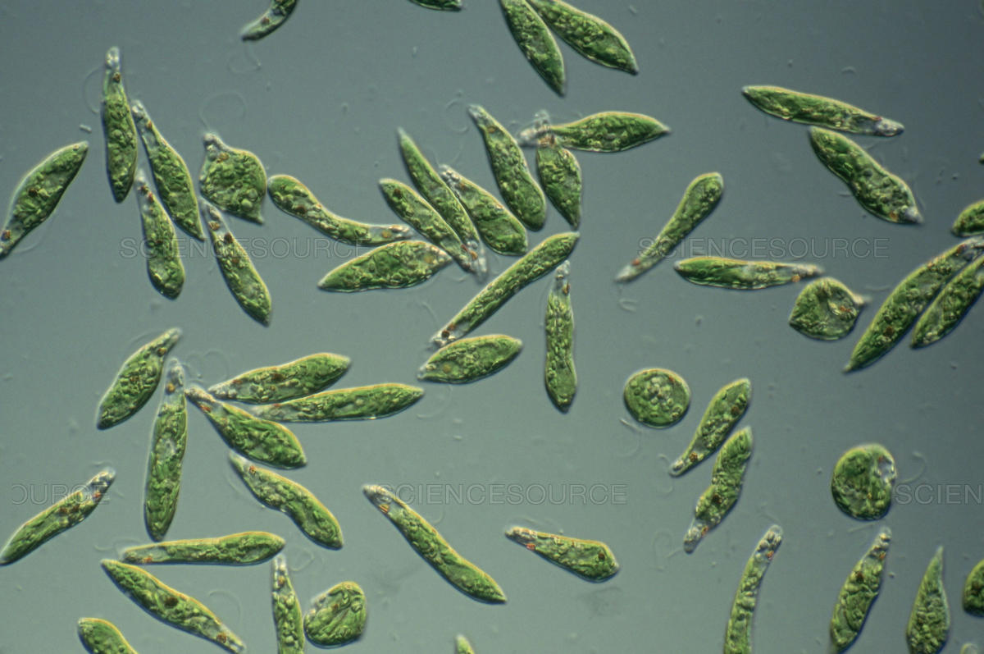
Euglena is a protist mixotroph

Slide 17
Protist reproduction
Some protists reproduce asexually only
Some protists reproduce sexually
Some protists have complex life cycles which have asexual life stages and a sexual stage

Slide 18
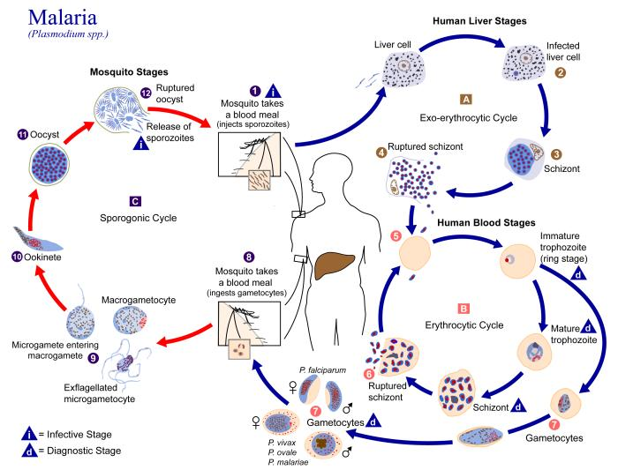
Plasmidium is a protist with asexual and sexual reproduction

Slide 19
Protists

Slide 20
Learning Goals
Explain the evidence that supports the endosymbiotic theory of eukaryotic origins

Slide 21
Endosymbiosis in Eukaryotic Evolution
The endosymbiotic theory of eukaryotic evolution states that some of the organelles in today's eukaryotic cells—mitochondria and chloroplasts—were once free-living prokaryotic organisms that were engulfed by the ancestors of early eukaryotic cells
It also states that the endosymbiotic event that led to mitochondria happened before the endosymbiotic event that led to chloroplasts

Slide 22
Endosymbiosis in Eukaryotic Evolution: Evidence
Mitochondria and chloroplasts
The same size as prokaryotes
Undergo binary fission like prokaryotes, and divide independently of eukaryotic cell division
Possess their own genomes arranged in a closed loop, like prokaryotes

Slide 23
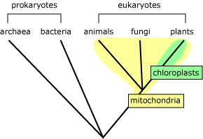
Endosymbiosis in Eukaryotic Evolution: Evidence
All eukaryotes have mitochondria
Only some eukaryotes have mitochondria and chloroplasts
This supports the theory that mitochondrial endosymbiosis came first

Slide 24
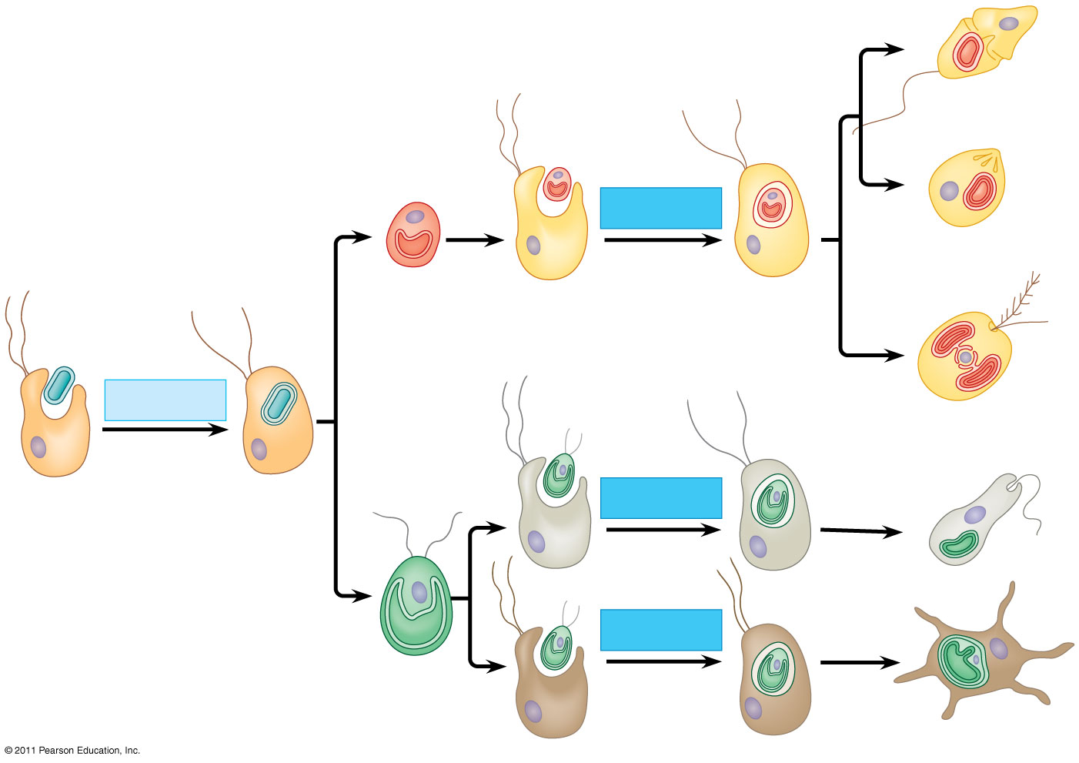
Figure 28.2
Secondary endosymbiosis
Plastid
Dinoflagellates
Secondary endosymbiosis
Membranes are represented as dark lines in the cell.
Apicomplexans
Red alga
Cyanobacterium
1
2
3
Primary endosymbiosis
Stramenopiles
Heterotrophic eukaryote
Secondary endosymbiosis
Plastid
One of these membranes was lost in red and green algal descendants.
Euglenids
Secondary endosymbiosis
Green alga
Chlorarachniophytes
Notes:
Figure 28.2 Diversity of plastids produced by endosymbiosis.

Slide 25
Protists

Slide 26
Learning Goals
Interpret information from a phylogenetic tree

Slide 27
Examples of phylogenetic trees

Slide 28
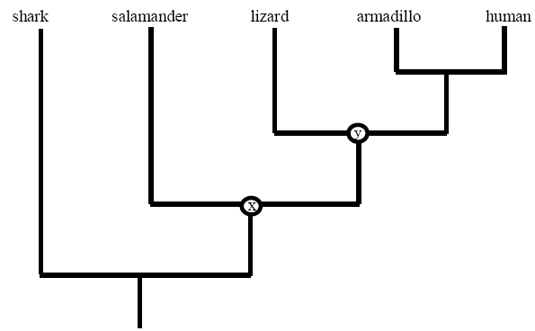
Reading phylogenetic trees
A phylogenetic tree is a diagram that represents evolutionary relationships among organisms
The pattern of branching in a phylogenetic tree reflects how species or other groups evolved from a series of common ancestors
Phylogenetic trees are evidence-supported hypotheses, not definitive facts

Slide 29
Reading phylogenetic trees
Two species are more related if they have a more recent common ancestor and less related if they have a less recent common ancestor
Each branching point is called a node, and represents the most recent common ancestor of all species that branch from that node

Slide 30
Reading phylogenetic trees
The pattern of branching in a phylogenetic tree depicts how species or other groups evolved from a series of common ancestors

Slide 31
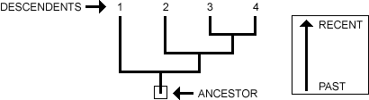
Reading phylogenetic trees
Each branch tip represents a living descendent.
The base of the tree represents an ancestor in the past

Slide 32

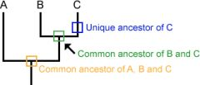
Reading phylogenetic trees
A Phylogeny traces patterns of shared ancestry between descendents. Each descendent (A, B, C) has a part of its history that is unique to its lineage alone and parts that are shared with other lineages.
Moreover, each descendent has recent ancestors that are unique to that lineage and older ancestors that are shared with other lineages

Slide 33
Example
Humans share a more recent common ancestor with armadillos than with lizards.
Humans share a more recent common ancestor with lizards than with salamanders.
Lizards are more closely related to humans than to salamanders. Why?

Slide 34
Protists

Slide 35
Learning Goals
Identify protist lineages that gave rise to animals, plants, and fungi

Slide 36
4 “Supergroups” of Protists
Excavata
SAR
Archaeplastida
Unikonta

Slide 37
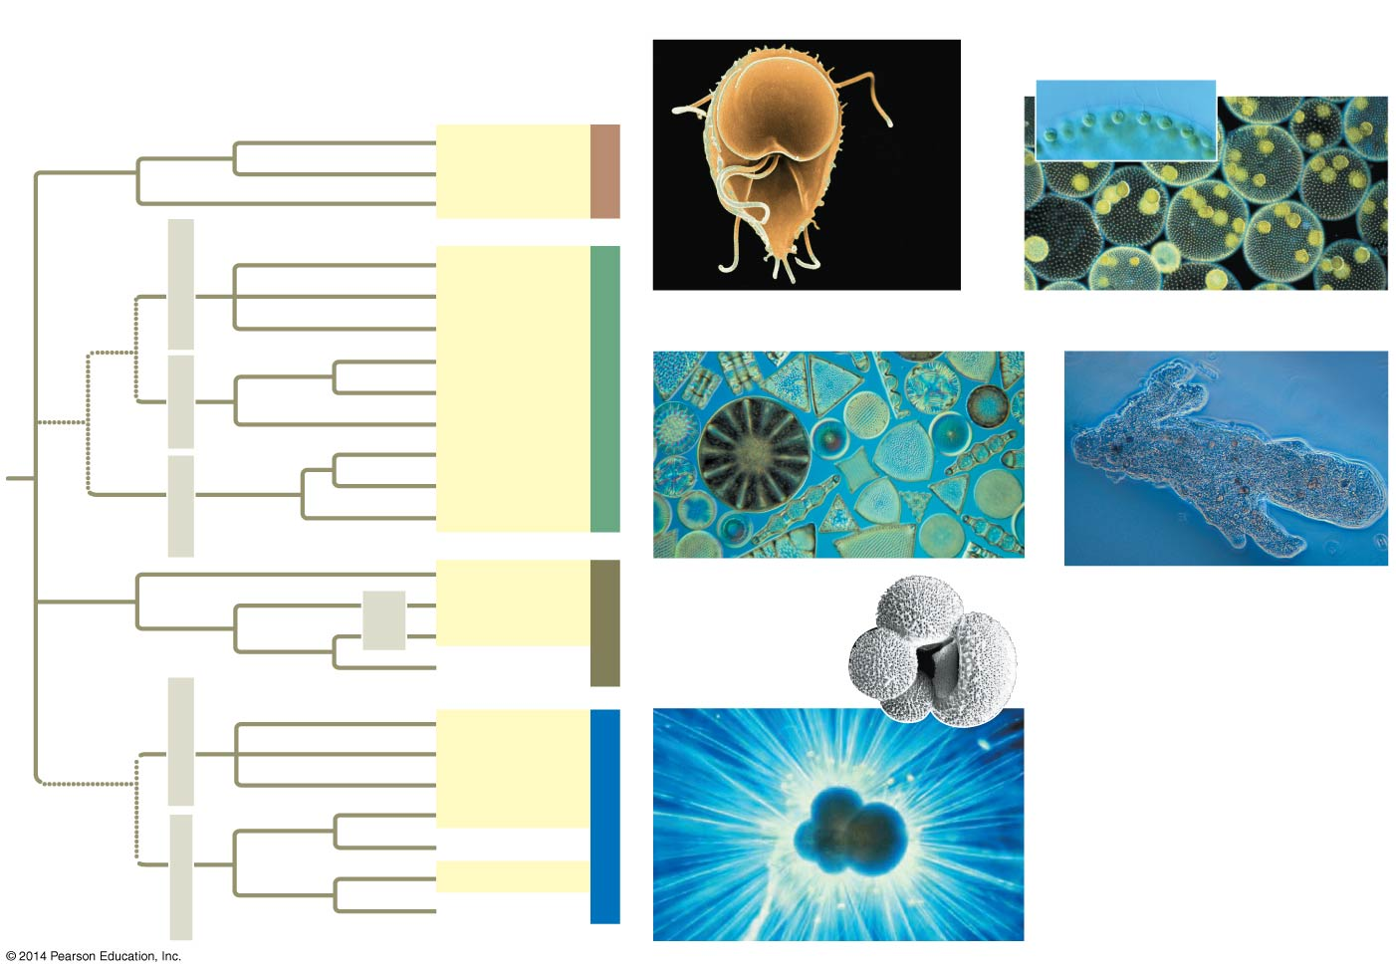
Figure 28.2
■ Excavata
5 μm
■ Archaeplastida
20 μm
50 μm
Diplomonads
Parabasalids
Excavata
Euglenozoans
Diatoms
Stramenopiles
Golden algae
Brown algae
■ “SAR” Clade
50 μm
■ Unikonta
Dinoflagellates
Alveolates
Apicomplexans
“SAR” clade
Ciliates
Forams
Cercozoans
Rhizarians
Radiolarians
Red algae
100 μm
Green algae
Chlorophytes
Archaeplastida
Charophytes
Land plants
100 μm
Slime molds
Amoebozoans
Tubulinids
Entamoebas
Nucleariids
Unikonta
Fungi
Opisthokonts
Choanoflagellates
Animals
Notes:
Figure 28.2 Exploring protistan diversity

Slide 38
Excavata
Contains 3 major lineages
It includes Trychonympha (living in termite guts) and Euglena (the mixotroph)

Slide 39
SAR
SAR refers to three major lineages within the group
Stramenophiles, Alveolates, Rhizarians

Slide 40
Stramenophiles
Photosynthetic
diatoms
golden algae
brown algae (multicellular)

Slide 41
Alveolates
Photosynthetic dinoflagellates that build coral reefs
Pathogen Phytophthora that caused the Irish potato famine
Pathogen Plasmodium that causes malaria

Slide 42
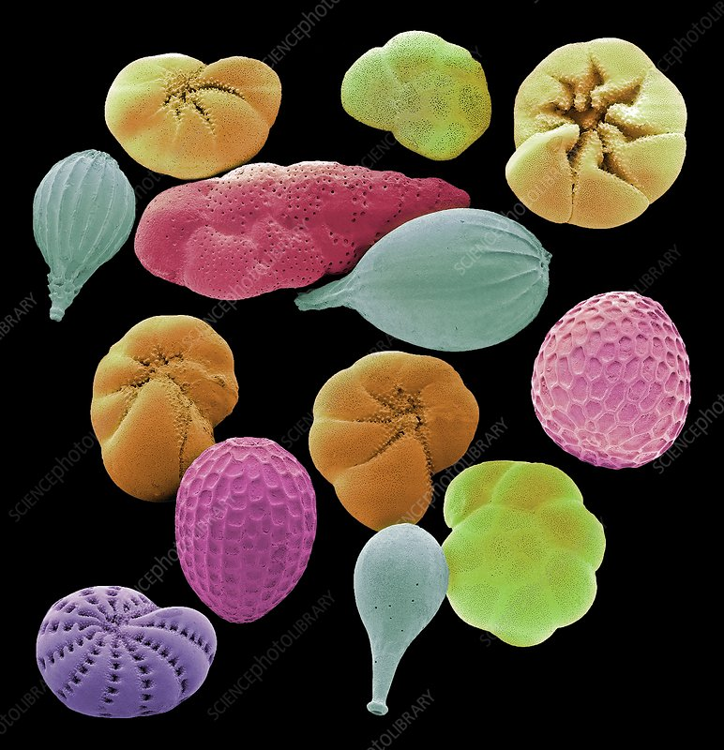
Rhizarians
Foraminifera - form calcium carbonate shells, live in fresh and salt water
Lots are known from fossils, they play an important role in dating sedimentary rocks and tracking ancient climates

Slide 43
Archaeplastida
Includes three major lineages
red algae
green algae
A lineage that gave rise to plants

Slide 44
Unikonta
Includes three major lineages
One lineages includes only protists, including slime molds
One lineage that gave rise to fungi
One lineage that gave rise to animals

